Slide 1

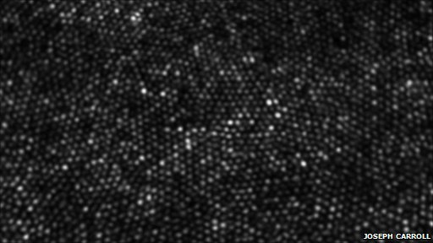
Myopic deconvolutioon
Gabriel Gostiaux
IOGS 3A
BBC news
Use case in retina imaging
https://github.com/GabrielGst/IO-PTI

Slide 2
Summary
Introduction
Retina imaging using adaptative optics
Structure of the retina and model
Classic imaging vs confocal and SIM
Object reconstruction with classic imaging techniques
Building the synthetic image for model evaluation
Bayesian estimation, joint and marginal estimation
Results with real retina images
Future implementations
Hyper-parameters estimation

Slide 3
Goals & barriers
Introduction
Detect and characterize retina aging, glaucomas…
Early detection of parkinson & alzheimer diseases (photoreceptors are neurones !!)
Detect and characterize diabète (by looking at blood vessels)
High precision surgical techniques (high precision laser surgery)
Vitreous body, eye shaking, aberrations due to the eye lens and lacrimal film

Slide 4
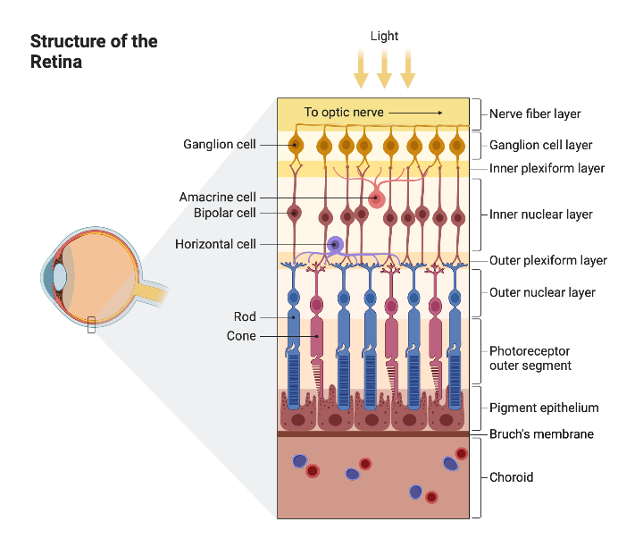


Imaging photo-receptors
Retina imaging using adaptative optics
Structure of the retina and model
We defines the 3D PSF as an average mean of 2D PSF at different deepnesses
We assume that our object is shift invariant along the optical axis:

Slide 5
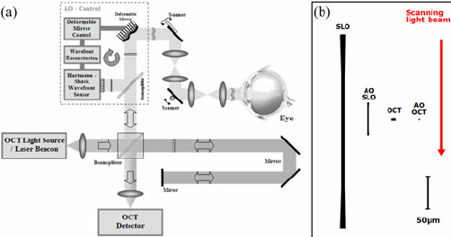
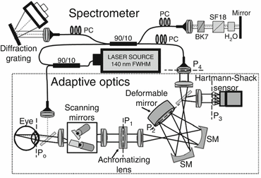
Imaging techniques
Retina imaging using adaptative optics
Classic imaging vs confocal and SIM
Classic imaging : acquisition of fore ad back ground low frequency noise
Confocal imaging : separation of the selected layer but geometric aberration with eye movement
Structured Illumination Microscopy : separation of the selected layer and abstraction of geometric aberration by using Fourier space
Classic imaging (or confocal illumination system)
SIM – Structured Illumination Microscopy

Slide 6
Summary
Introduction
Retina imaging using adaptative optics
Structure of the retina and model
Classic imaging vs confocal and SIM
Object reconstruction with classic imaging techniques
Building the synthetic image for model evaluation
Bayesian estimation, joint and marginal estimation
Results with real retina images
Future implementations
Hyper-parameters estimation

Slide 7
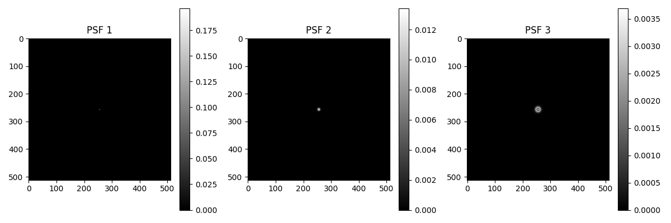
Deconvolving the right layer
Object reconstruction with classic imaging techniques
Building the synthetic image for model evaluation

Slide 8

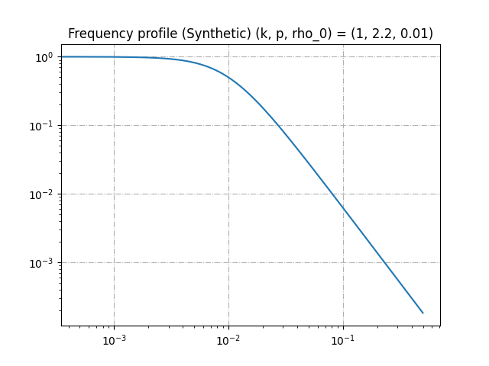
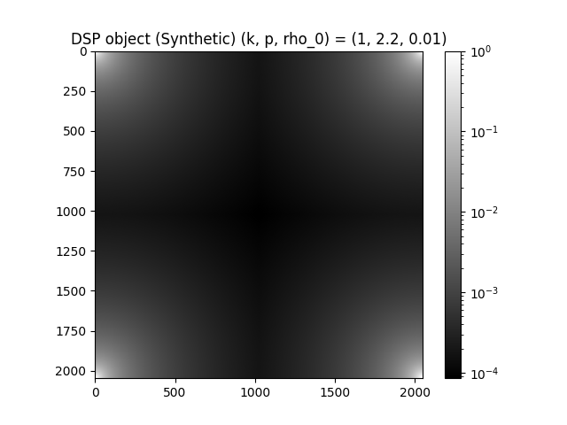
Building a synthetic image
Object reconstruction with classic imaging techniques
Building the synthetic image for model evaluation

Slide 9
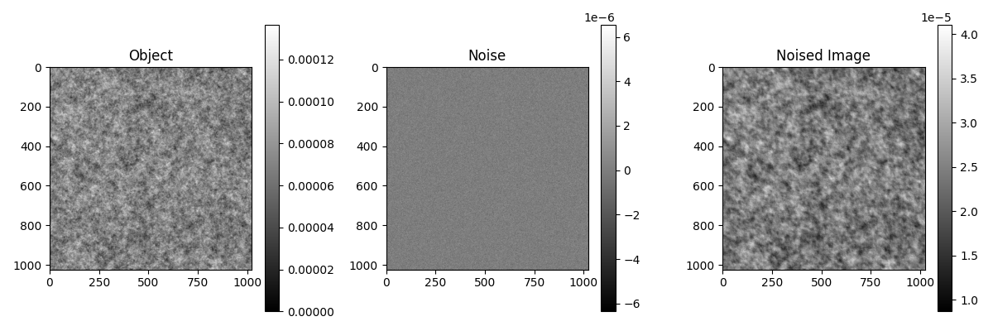
Building a synthetic image
Object reconstruction with classic imaging techniques
Building the synthetic image for model evaluation

Slide 10
Summary
Introduction
Retina imaging using adaptative optics
Structure of the retina and model
Classic imaging vs confocal and SIM
Object reconstruction with classic imaging techniques
Building the synthetic image for model evaluation
Bayesian estimation, joint and marginal estimation
Results with real retina images
Future implementations
Hyper-parameters estimation

Slide 11





Simultaneous estimation of object and PSF
Object reconstruction with classic imaging techniques
Bayesian estimation, joint and marginal estimation
In the following we will use the expressions :
Here, we will work with only two PSF, the in focus and out of focus ones :
We recall that Bayesian statistics uses :

Slide 12
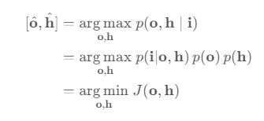

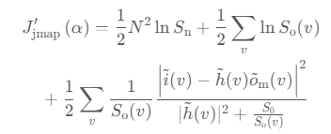
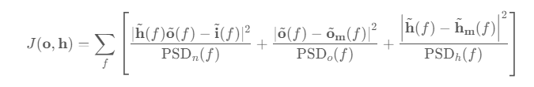
Simultaneous estimation of object and PSF
Object reconstruction with classic imaging techniques
Bayesian estimation, joint and marginal estimation
We need to estimate the pair (o, h). Using the Bayesian framework
We find an analytical formula for the estimated object by cancelling the object derivative of the criterion :
We find a criterion composed of a mean square error, and two regularization terms (object and PSF) :
By substituting this expression in the criterion formula, we get :

Slide 13
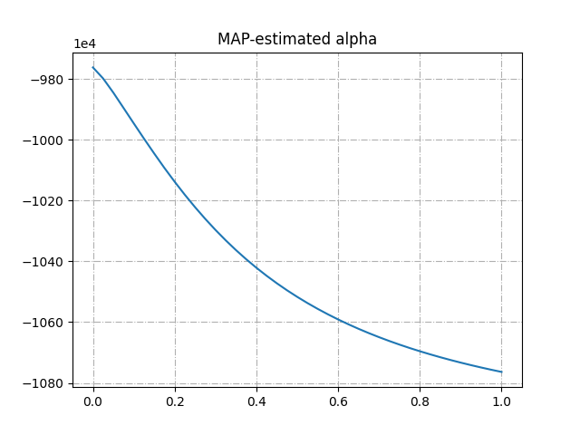
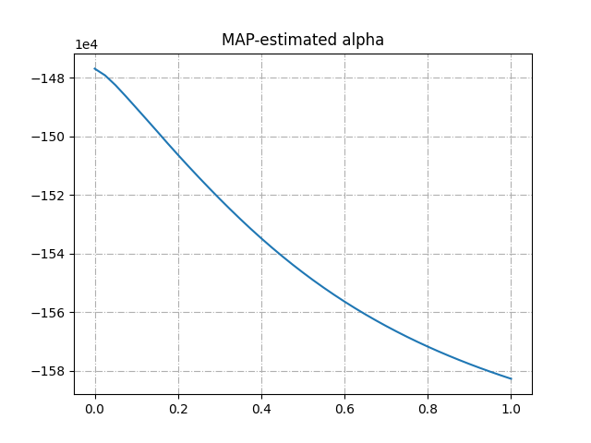
Poor results of joint estimation
Object reconstruction with classic imaging techniques
Bayesian estimation, joint and marginal estimation
Synthetic image
Real image

Slide 14




Marginal estimation of the PSF
Object reconstruction with classic imaging techniques
Bayesian estimation, joint and marginal estimation
By integrating over all possible objects (using a stack of recorded images) we can remove the estimation of the object from the problem of estimating the PSF
We then take the log and therefore compute the Maximum Likelihood Estimator by minimizing the opposite
Since we only have a few alphas, we can skip its regularization. Integrating over o simplifies the expression of the probability law that depend only on the average object

Slide 15
Summary
Introduction
Retina imaging using adaptative optics
Structure of the retina and model
Classic imaging vs confocal and SIM
Object reconstruction with classic imaging techniques
Building the synthetic image for model evaluation
Bayesian estimation, joint and marginal estimation
Results with real retina images
Future implementations
Hyper-parameters estimation

Slide 16
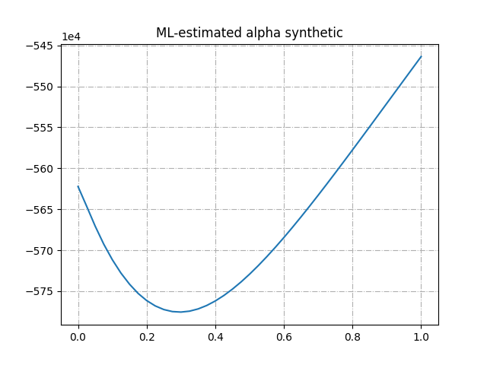
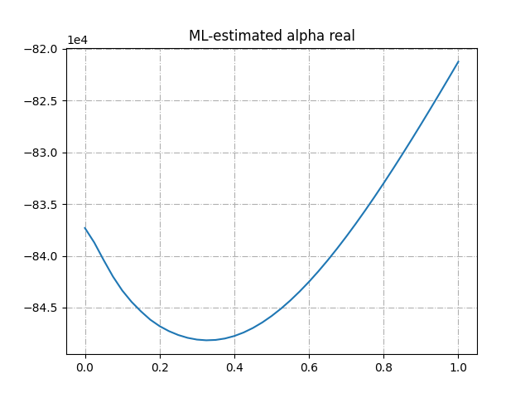
Good results with marginal estimation
Results with real retina images
With synthetic & real image

Slide 17
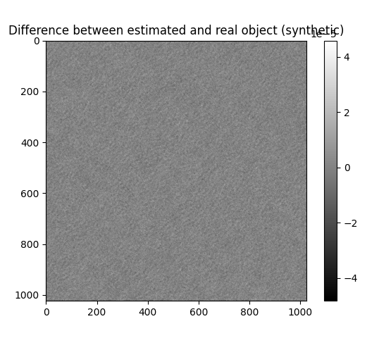
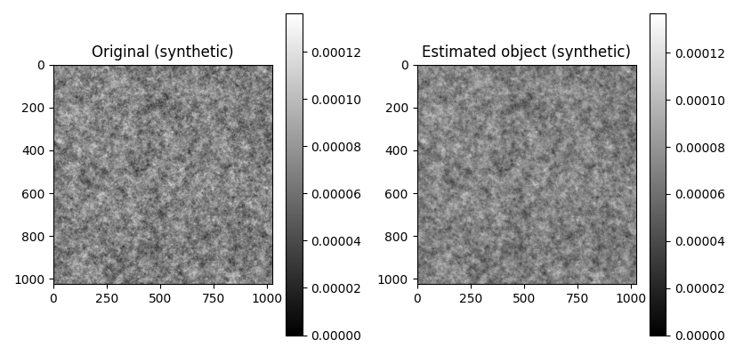
Estimating synthetic object
Results with real retina images
With synthetic & real image

Slide 18
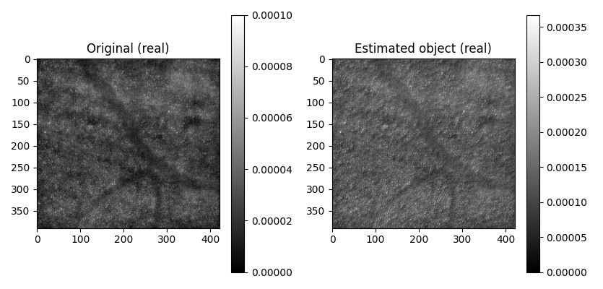
Good results real retina images
Results with real retina images
With synthetic & real image

Slide 19
Summary
Introduction
Retina imaging using adaptative optics
Structure of the retina and model
Classic imaging vs confocal and SIM
Object reconstruction with classic imaging techniques
Building the synthetic image for model evaluation
Bayesian estimation, joint and marginal estimation
Results with real retina images
Future implementations
Hyper-parameters estimation

Slide 20
Estimating hyper-parameters
Future implementations
Hyper-parameters estimation
We still have to estimate manually the hyper parameters :
Noise DSP is estimated as 5% of maximum of image (between 1% and 20%)
Object DSP is estimated with parameters (k, p, f_c) = (1, 2.2, 0.01)
We used only two PSF when three were available : a new algorithm using optimization techniques such as gradient descent could be implemented to integrate the third PSF and hyper-parameter estimation

Slide 21

Myopic deconvolutioon
Gabriel Gostiaux
IOGS 3A
Thank you for your attention !
Use case in retina imaging
https://github.com/GabrielGst/IO-PTI

